Slide 1

Testing in PowerShell
Unit testing, integration tests
and Operational testing
Jaap Brasser
@Jaap_Brasser

Slide 2

About_Jaap
Dutch PowerShell User Group (!!!)
Blogging
PowerShell Magazine
JaapBrasser.com
Slack
Reddit
GitHub
PowerShell Gallery
TechNet Forums/Gallery
@Jaap_Brasser

Slide 3
Agenda
Why testing and what are some benefits
Basic concepts of Pester
Writing Unit tests
Writing Integration tests
Operational testing

Slide 4

Why testing and what are some benefits

Slide 5
Reasons for testing
Provide a framework for updating scripts
Write integration tests to verify scripting functionality
Verify operational functionality
Analyze and improve scripting habits

Slide 6
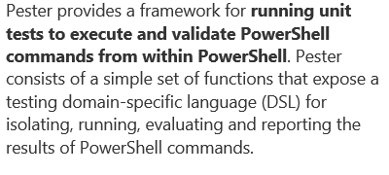
What is Pester

Slide 7
Advantages of Pester
Is shipped with Windows
Used by the PowerShell team
Works in familiar notation
Actively maintained and updated on GitHub

Slide 8
Basic concepts of Pester
Describe
Context
It
Should
BeforeEach
AfterEach
In
New-Fixture
Invoke-Pester
New-PesterOption
Mock
InModuleScope
Assert-MockCalled
Assert-VerifiableMocks

Slide 9
Should operators
Different syntax when compared to PowerShell
Different naming from the operators in PowerShell
Mostly similar results when compared to PowerShell operators

Slide 10
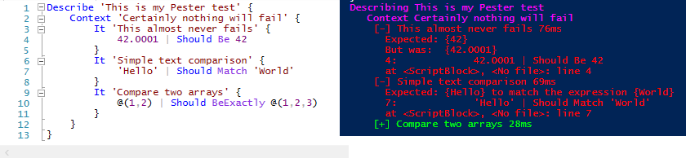
Demo 1 – Successful Tests

Slide 11
Demo Summary
How to create a simple pester test
How the Pester Syntax differs from regular PowerShell

Slide 12
Demo 2 – Failed Tests

Slide 13
Demo Summary
What happens if a Pester Test fails
Error messages for curly brace on next line

Slide 14
Demo 3 – Mocking and ModuleScope

Slide 15
Demo Summary
How to mock a function or module
Mock the smallest component
How to mock when working with modules

Slide 16
Demo 4 – Pester TestDrive:\

Slide 17
Demo Summary
View how the TestDrive: is initialized
Use for temporary storage in the current Pester Scope
How to use this in your testing

Slide 18
Demo 5 – Pester output

Slide 19
Demo Summary
Run Pester using Invoke-Pester
Define different output type
Access the different test results using the XML output
Useful for automating your testing

Slide 20
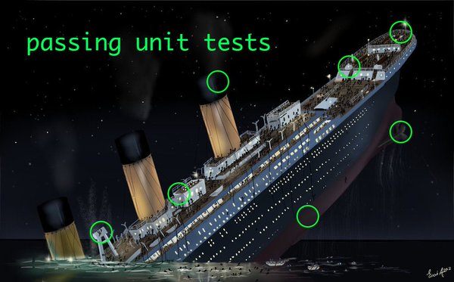
Write unit tests

Slide 21
Why unit tests
A way of testing components in your scripts and functions
Can be fully automated
Tests a single component
Hard to write (when inexperienced)

Slide 22
Demo Unit Testing

Slide 23
Demo Summary
Function that exports dates based on strings
Singled out a component to test
Verified that breaking code intentionally was seen in the tests

Slide 24
Write integration tests
Used to test functionality of a function or collection of functions
Test functionality of a script

Slide 25
Demo – Integration Test

Slide 26
Demo Summary
Run the entire function
Test various aspects of the function
Is there output
Type of output

Slide 27
Operational testing
Test your infrastructure
Verify changes in infrastructure
Useful in the following scenarios:
Migrations
New deployments
When incidents occur
Automatically verify critical systems

Slide 28
Demo 1 – Test installed components

Slide 29
Demo summary
Verified that required software is installed
Verified version of PowerShell
Verified various registry settings
Added PowerShell to Win+X

Slide 30
Demo 2 – Test Fileshares

Slide 31
Demo summary
Show content of the CliXml file
Show similar results
Use Pester tests
Investigated the differences

Slide 32
Demo 3 – Linux testing

Slide 33
Demo summary
Run PowerShell scripts / Pester tests on Linux
Verify software installation on Linux
Check PowerShell version and edition

Slide 34
Questions?

